Slide 1
The Rady School of Management
MGT 103
Lecture #11
Managing Successful Products & Services
Branding
Wednesday, February 19, 2020

Slide 2
Announcements – February 19th
Mid-Term Results
Average class grade = 82%
25% of total class grade, plenty of time to improve!
Rady Labs reminder- please complete your Rady assignment as soon as possible!
<70%, please set office hour appointment!
Office hours on Thursday this week; 2:00 – 3:00 p.m. 2E108

Slide 3
Group Work – Marketing Plan Project
Ensure everyone has a group!
Brainstorm – what new products/services can we launch?
Group Leader
Must attend mandatory office hours for Project Review- Monday, February 24 @1:30 – 2:30
Organized; Power Point guru!
Group Leader- send Marketing Plan idea and group member roles to Alli by 5:00 p.m. Friday, February 21.

Slide 4
LEARNING OBJECTIVES (LO) AFTER READING CHAPTER 11 YOU SHOULD BE ABLE TO:
Explain the product life-cycle concept.
Identify the ways that marketing executives manage a product’s life cycle.
Recognize the importance of branding and alternative branding strategies.
Describe the role of packaging and labeling in the marketing of a product.

Slide 5


GATORADE: BRINGING BRINGING SCIENCE TO SWEAT FOR MORE THAN 50 YEARS
Synonymous with Sports Drinks
Global Brand
Sold in Over 80 Countries
Official Drink of NASCAR, NFL, MLB, NBL, NHL, MLS, and WNBA
Brand Repositioning – G-Series
Continuous Product Development
Gatorade Ad
©J. Meric/Getty Images

Slide 6
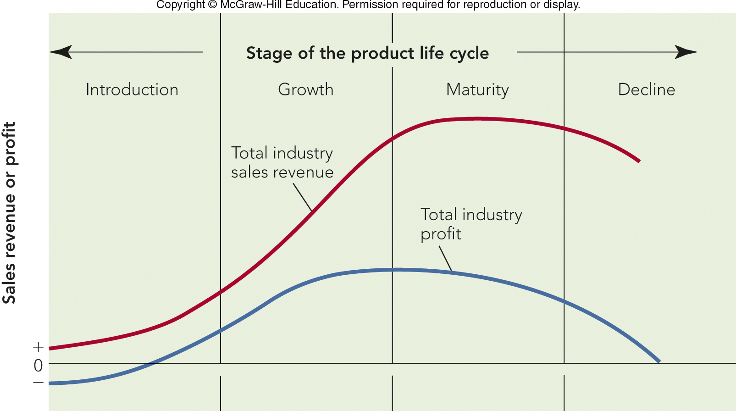
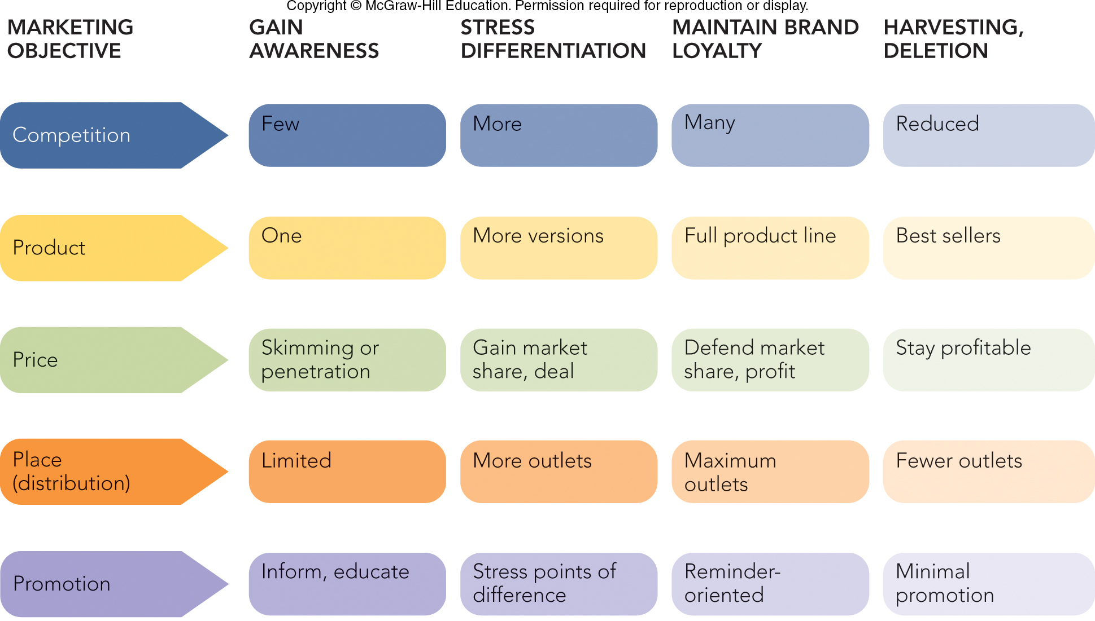
FIGURE 11-1 How stages of the product life cycle relate to a firm’s marketing objectives and marketing mix actions.

Slide 7
FIGURE 11-1A Stages of the product life cycle and its total industry sales and total industry profit

Slide 8
FIGURE 11-1B How stages of the product life cycle relate to a firm’s marketing objectives and marketing mix actions
Jump to Appendix 2 long image description

Slide 9

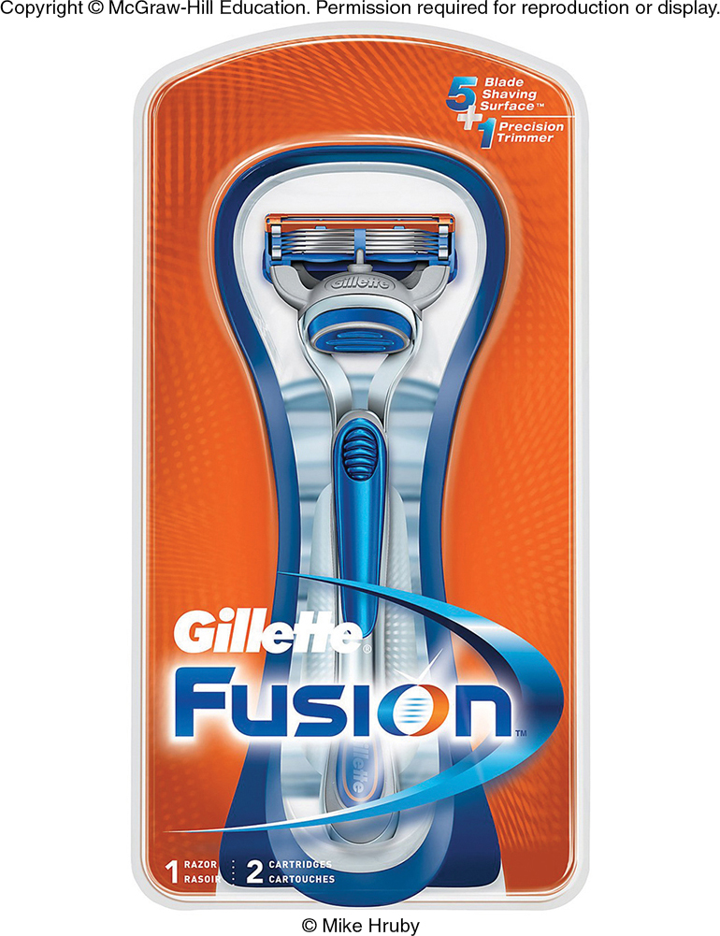
CHARTING THE PRODUCT LIFE CYCLE INTRODUCTION STAGE
Product Life Cycle
Introduction Stage:
Stimulate Trial
Primary Demand
Selective Demand
Skimming Strategy
Penetration Pricing
Gillette Fusion
ProGlide
Top: ©Samuel Corum/Anadolu Agency/Getty Images; Bottom: ©McGraw-Hill Education/Mike Hruby, photographer

Slide 10
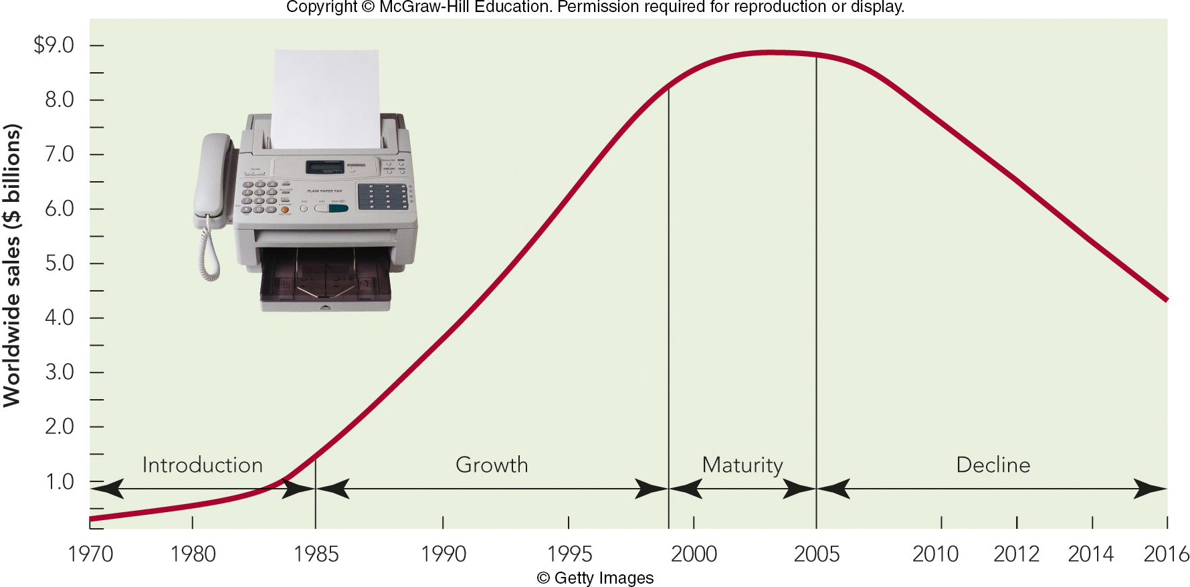
FIGURE 11-2 Product life cycle for the stand-alone fax machine for business use: 1970-2016.
Jump to Appendix 3 long image description

Slide 11
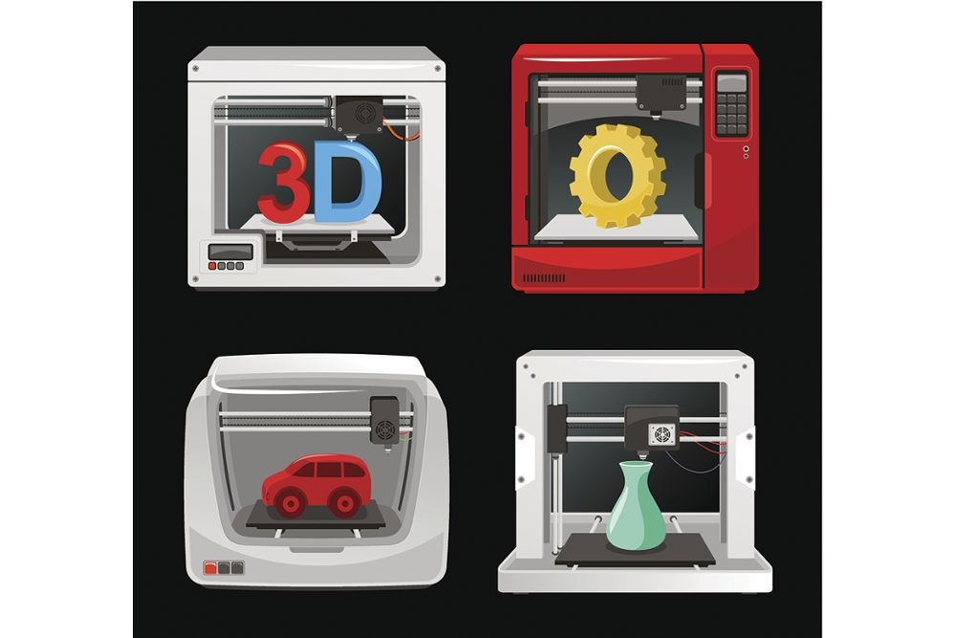
CHARTING THE PRODUCT LIFE CYCLE GROWTH STAGE
Growth Stage:
Rapid Sales Growth
More Competitors
Profits Peak
Advertising Shifts to Selective Demand
Repeat Purchasers
New Features
Broad Distribution
Kindle
©Tomacco/iStock/Getty Images

Slide 12
CHARTING THE PRODUCT LIFE CYCLE MATURITY STAGE
Maturity Stage:
Industry/Product Sales Slow
Fewer New Buyers
Profit Declines
Product Differentiation
Fewer Competitors
Examples: Soft Drinks, Breakfast Cereals

Slide 13
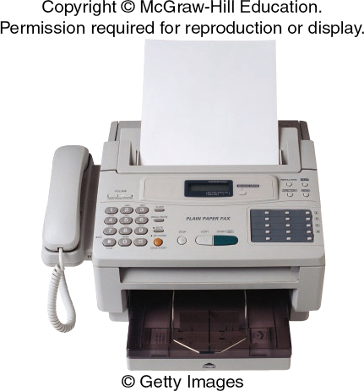
CHARTING THE PRODUCT LIFE CYCLE DECLINE STAGE
Decline Stage:
Industry/Product Sales Drop
Price Drops
Environmental Changes
Deletion
Harvesting
©Getty Images

Slide 14
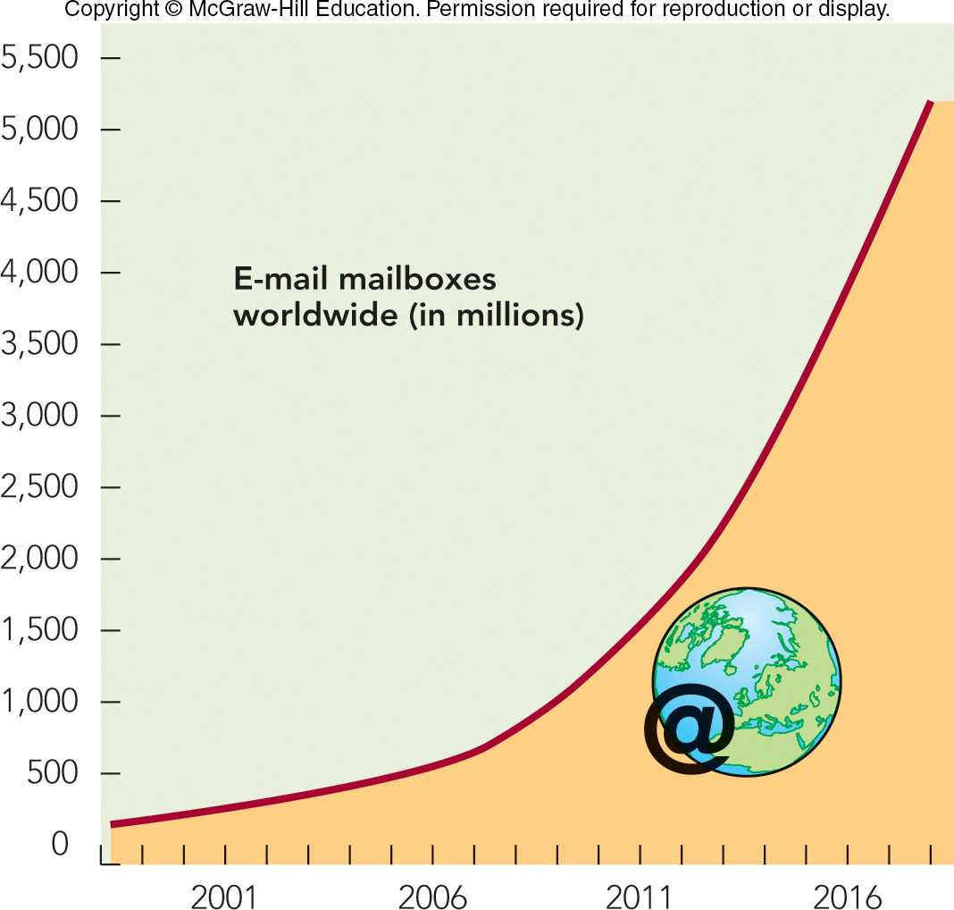
MARKETING MATTERS Will E-Mail Spell Extinction for Fax Machines?
E-mail – Text Messages
Faxes – Formatted Documents
Security Concerns
Will Slack kill email?

Slide 15
CHARTING THE PRODUCT LIFE CYCLE THREE ASPECTS (1 of 2)
Length of the Product Life Cycle
Shape of the Product Life Cycle
Generalized Life Cycle
High-Learning Product
Low-Learning Product
Fashion Product
Fad Product
Rate of Consumer Adoption

Slide 16
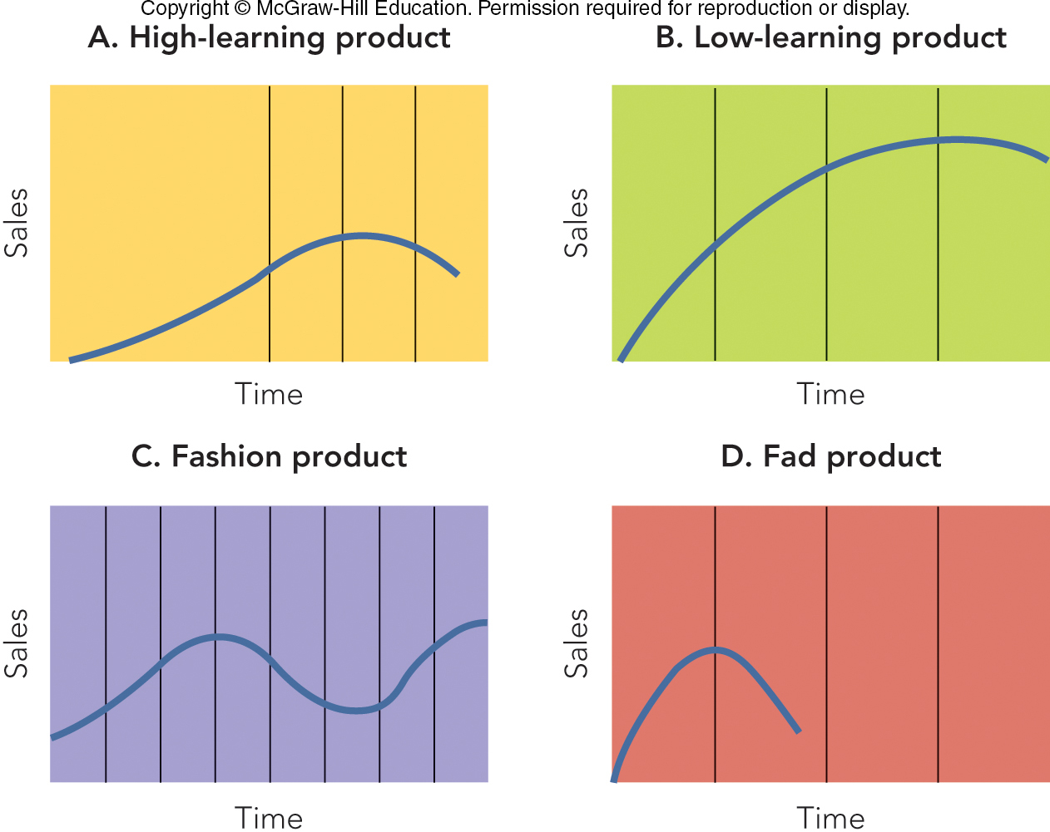
FIGURE 11-3 Alternative product life-cycle curves based on product types
Jump to Appendix 5 long image description

Slide 17
THE PRODUCT LEVEL: CLASS AND FORM
Product Class
The Entire Product Category or Industry
Ex: Prerecorded Music
Product Form
Variations of a Product Within the Product Class
Examples: Cassettes, CDs, Music Streaming

Slide 18
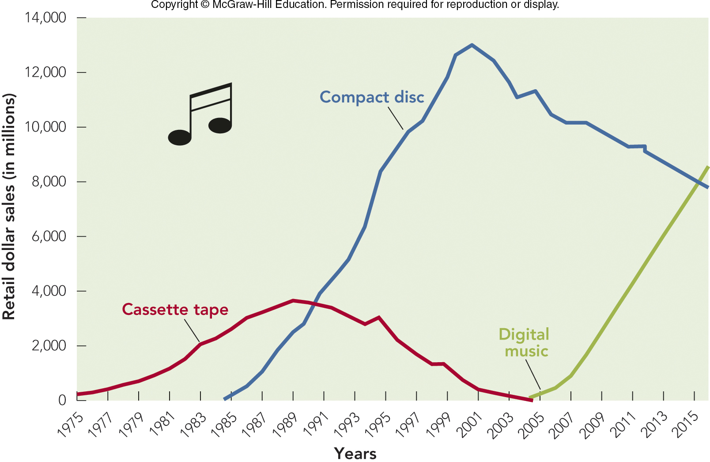
FIGURE 11-4 Prerecorded music product life cycles by product form.

Slide 19
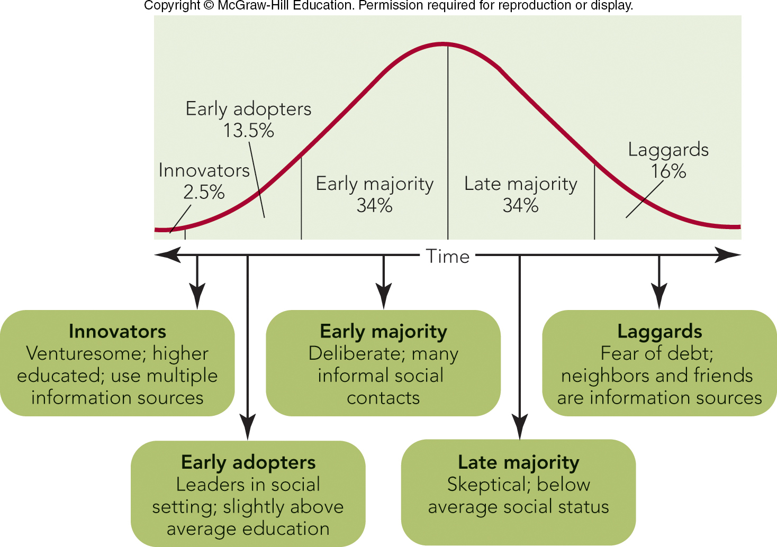
FIGURE 11-5 Five categories and profiles of product adopters (diffusion of innovation).
Jump to Appendix 7 long image description

Slide 20
CHARTING THE PRODUCT LIFE CYCLE FOUR ASPECTS
The Life Cycle and Consumers
Barriers to Adoption
Usage
Value
Risk
Psychological

Slide 21
MANAGING THE PRODUCT LIFE CYCLE ROLE OF A PRODUCT MANAGER
Product/Brand Manager Responsibilities
Product Life Cycle
New Product Development
Marketing Program Implementation
Data Analysis
Category Development Index (CDI)
Brand Development Index (BDI)

Slide 22

MANAGING THE PRODUCT LIFE CYCLE MODIFYING THE PRODUCT OR MARKET
Product Modification
Product Bundling
New Characteristics
Market Modification
Finding New Customers
Increasing a Product’s Use
Creating a New Use Situation
Gillette Ad
©Gary Gardiner/Bloomberg via Getty Images

Slide 23
MANAGING THE PRODUCT LIFE CYCLE REPOSITIONING THE PRODUCT
Product Repositioning
Changes Place Product Occupies in Consumer’s Mind
Reacting to a Competitor’s Position
Reaching a New Market
Catching a Rising Trend
Changing the Value Offered
Trading Up
Trading Down
Downsizing: Reducing Content in Package

Slide 24
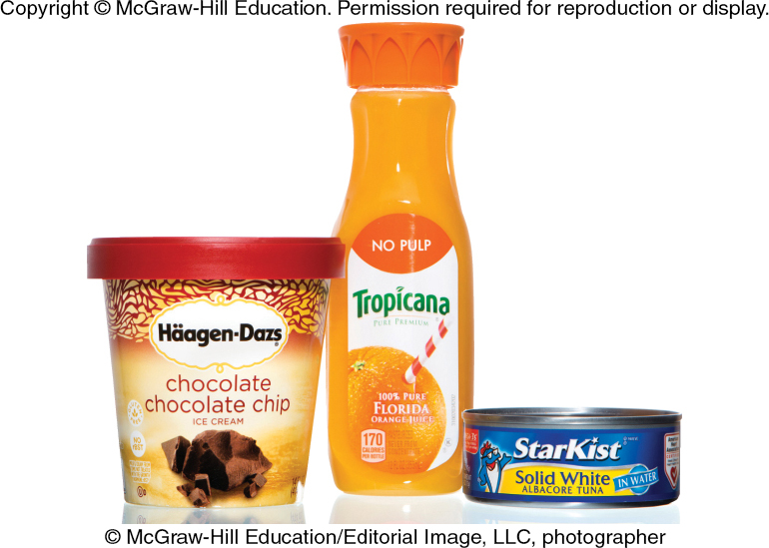
MAKING RESPONSIBLE DECISIONS Consumer Economics of Downsizing— Get Less, Pay More
Changing the Amount in Package
Less Product in Package While Maintaining the Package Size, Dimension, and Price
©McGraw-Hill Education

Slide 25
BRANDING AND BRAND MANAGEMENT BRAND PERSONALITY AND BRAND EQUITY (1 of 3)
Brand Personality
Brand Equity
Provides a Competitive Advantage
Consumers Willing to Pay a Premium
Dr. Pepper Ad

Slide 26
BRANDING AND BRAND MANAGEMENT BRAND PERSONALITY AND BRAND EQUITY (2 of 3)
Creating Brand Equity:
Develop Positive Brand Awareness
Establish a Brand’s Meaning for Consumers
Elicit the Proper Response to Brand’s Meaning
Create Intense Brand Loyalty with Consumers

Slide 27

BRANDING AND BRAND MANAGEMENT BRAND PERSONALITY AND BRAND EQUITY (3 of 3)
Valuing Brand Equity
Provides a Financial Advantage
Brands can be Bought and Sold
Brand Licensing
©Rebecca Sapp/WireImage for Mediaplacement/Getty Images

Slide 28
BRANDING AND BRAND MANAGEMENT PICKING A GOOD BRAND NAME
Brand Name Should:
Suggest Product Benefits
Be Memorable, Distinctive, and Positive
Fit the Company or Product Image
Have No Legal or Regulatory Restrictions
Be Simple and Emotional
Have Favorable Phonetic and Semantic Associations in Other Languages

Slide 29
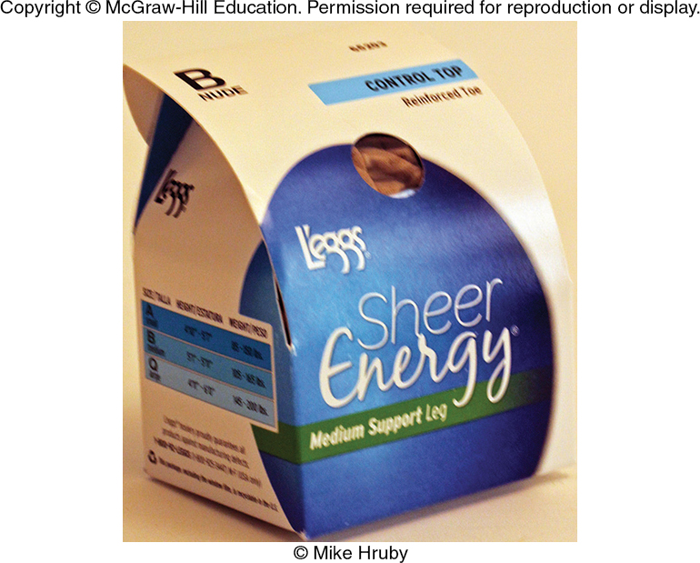
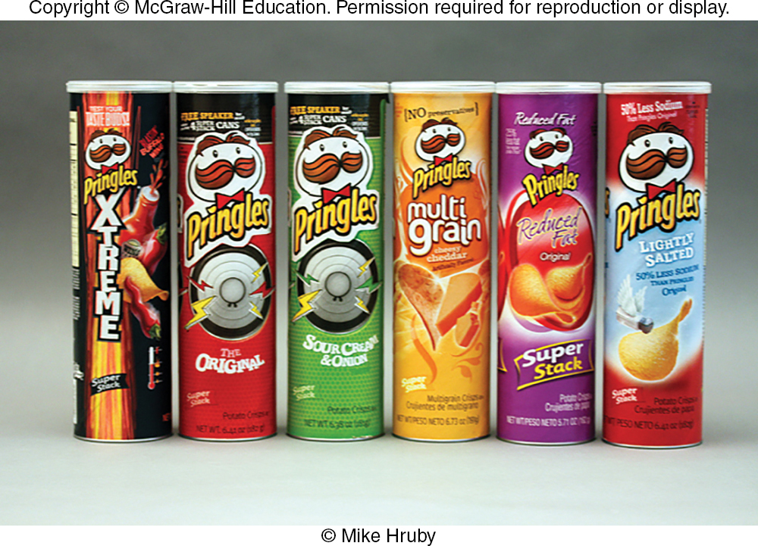
PACKAGING AND LABELING PRODUCTS CREATING CUSTOMER VALUE AND COMPETITIVE ADVANTAGE
Packaging and Labeling
Creates Customer Value and
Competitive Advantage
Communication Benefits
Functional Benefits
Perceptual Benefits
©McGraw-Hill Education/Mike Hruby, photographer

Slide 30
LEARNING OBJECTIVES (LO) Today’s Lecture Marketing Services
Describe four unique elements of services.
Recognize how services differ and how they can be classified.
Explain how consumers purchase and evaluate services.
Develop a customer contact audit to identify service advantages.
Explain the role of the seven Ps in the services marketing mix.
Discuss the important roles of internal marketing and customer experience management in service organizations.

Slide 31
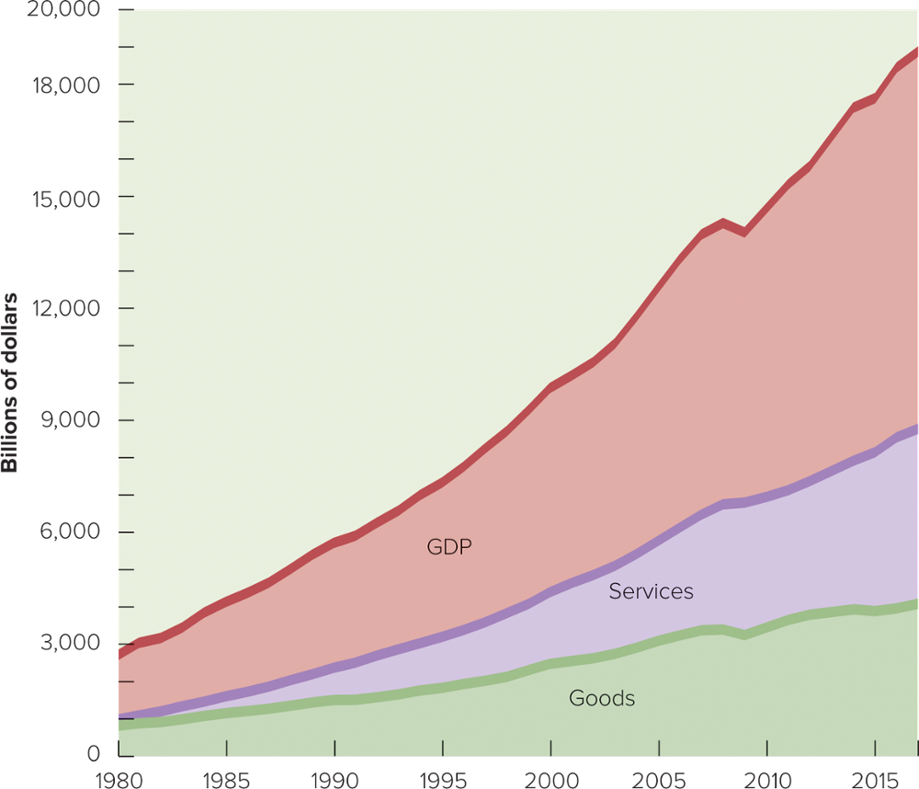
FIGURE 12-1 Services are a larger part of the U.S. GDP than goods

Slide 32
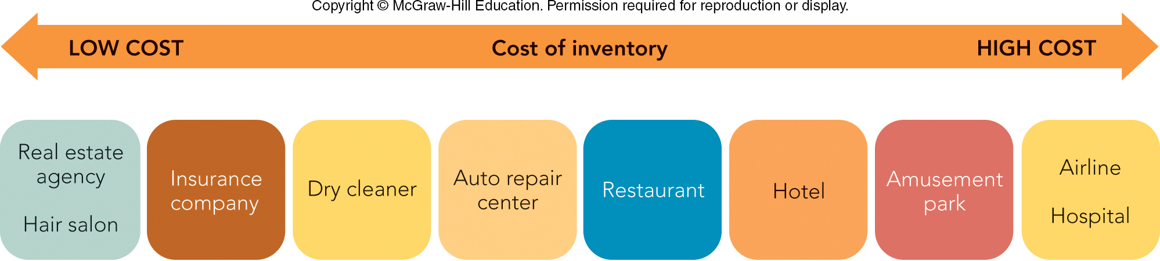
FIGURE 12-2 Inventory carrying costs of services depend on the cost of employees and equipment

Slide 33
HOW CONSUMERS PURCHASE SERVICES ASSESSING SERVICE QUALITY
Gap Analysis
Expectations and Experiences
Dimensions of Service Quality:
Reliability
Tangibility
Responsiveness
Assurance
Empathy

Slide 34
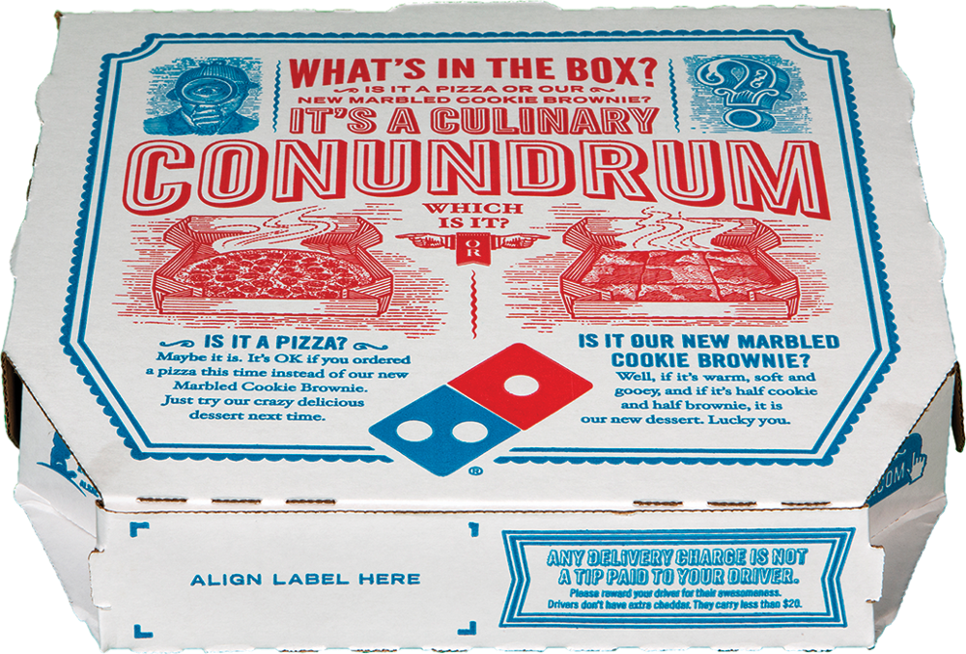
MARKETING MATTERS Managing Service Failures: The Importance of Monitoring and Guarantees
Only 5-10% of Dissatisfied Customers Complain
Instead, Customers Switch or Make Negative Comments
Companies Need to Respond to Service Failures
Service Guarantees with Two Parts:
Commitment to Good Service
Promise to Compensate if Service Poor (EXCEED EXPECTATIONS TO MAINTAIN
LOYALTY) – The moment of truth!
© Editorial Image, LLC

Slide 35
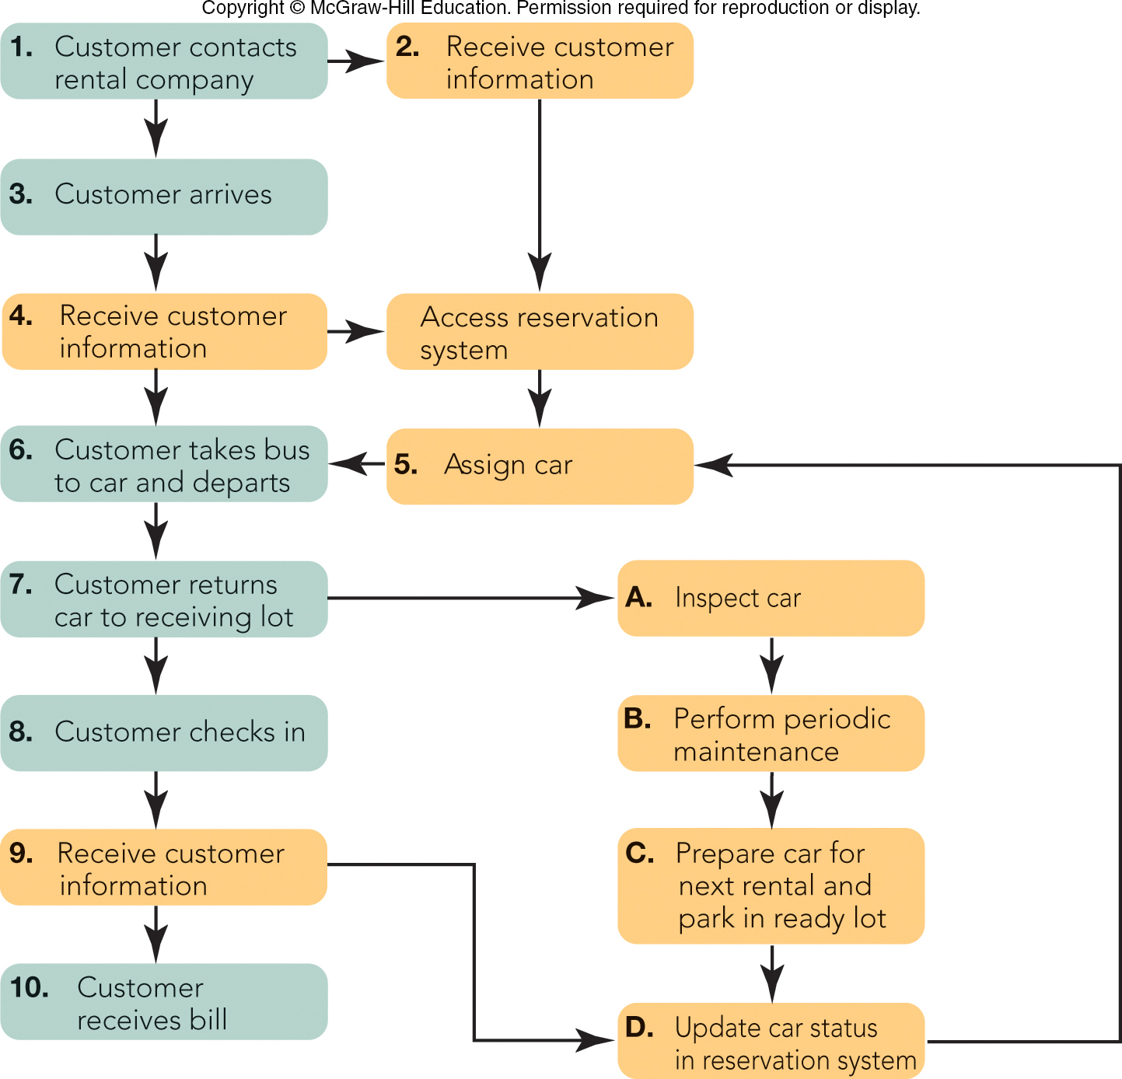
FIGURE 12-7 Customer contact audit for a car rental agency (green boxes = customer activity; orange boxes = employee activity)
Ideal workflow key to EXCELLENT service

Slide 36




MANAGING THE MARKETING OF SERVICES THE SEVEN Ps OF SERVICES (1 of 2)
Seven Ps of Services Marketing
Product (Service)
Branding
Price
Off-Peak Pricing
Place (Distribution)
Promotion
Publicity
Public Service Announcement (PSA)
First: © Agencja Fotograficzna Caro/Alamy Stock Photo Second: ©Don Emmert/AFP/Getty Image Third: ©Dennis Macdonald/Getty Images
Fourth: Courtesy of The Redirections Group

Slide 37
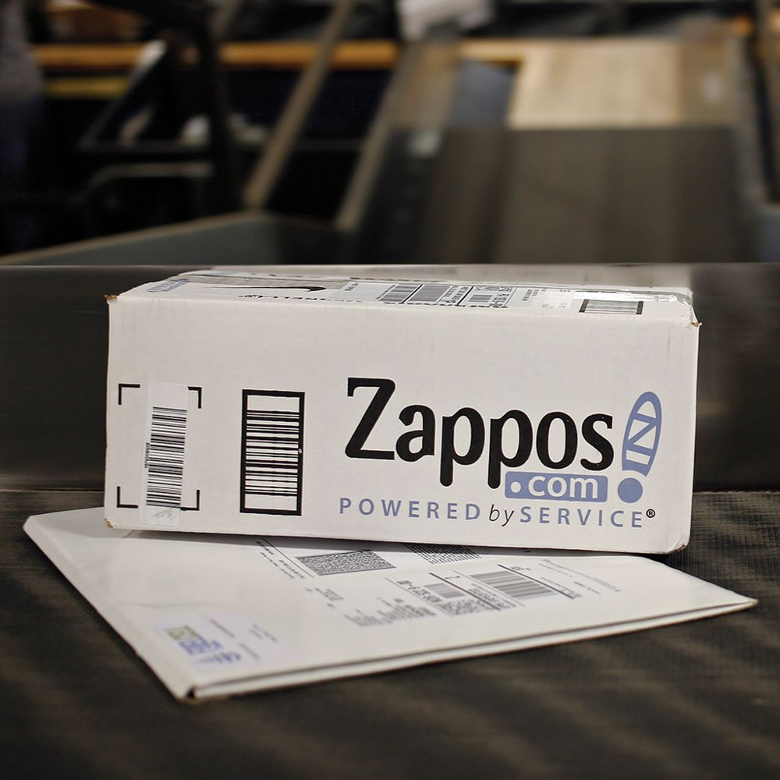
MANAGING THE MARKETING OF SERVICES THE SEVEN Ps OF SERVICES (2 of 2)
People
Service-Profit Chain
Customer Experience Management (CEM)
Physical Environment
Process
Capacity Management
© Luke Sharrett/Bloomberg via Getty Images

Slide 38
Next Time….Wednesday, February 24th
Read Chapters 13 and 14
Syllabus change - Homework will be assigned on Wednesday, February 26th
See you on Wednesday!

Slide 39
The Rady School of Management
MGT 103
Lecture #11
Managing Success Products & Services
Branding
Wednesday, February 19, 2020

Slide 40
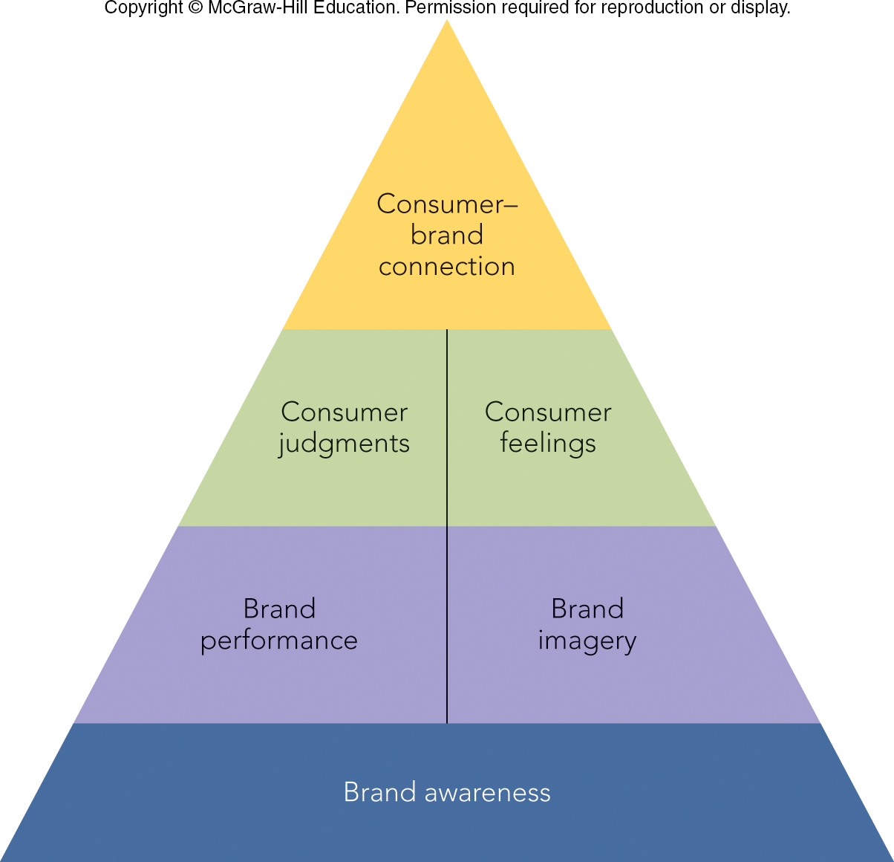
FIGURE 11-6 The customer-based brand equity pyramid
Jump to Appendix 9 long image description

Slide 41
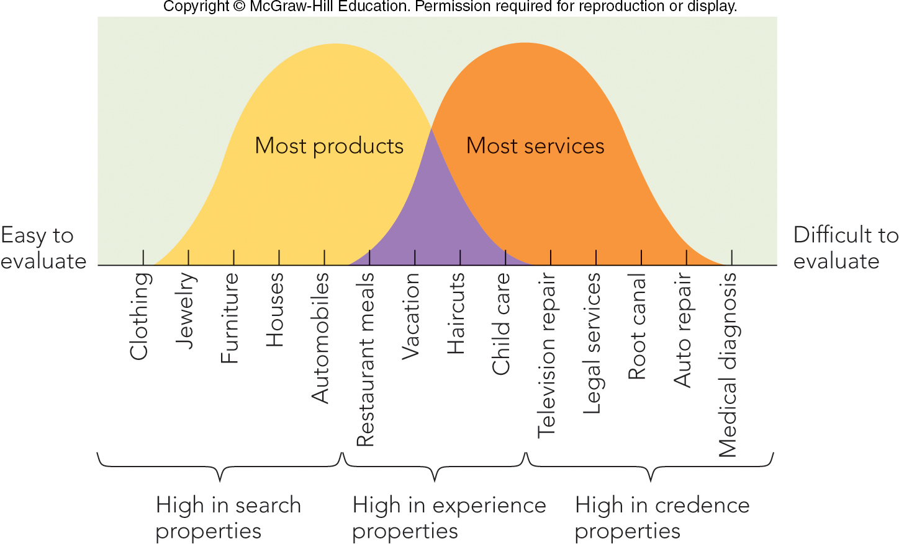
FIGURE 12-5 Consumers use search, experience, and credence properties to evaluate services
Jump to Appendix 5 long image description

Slide 42
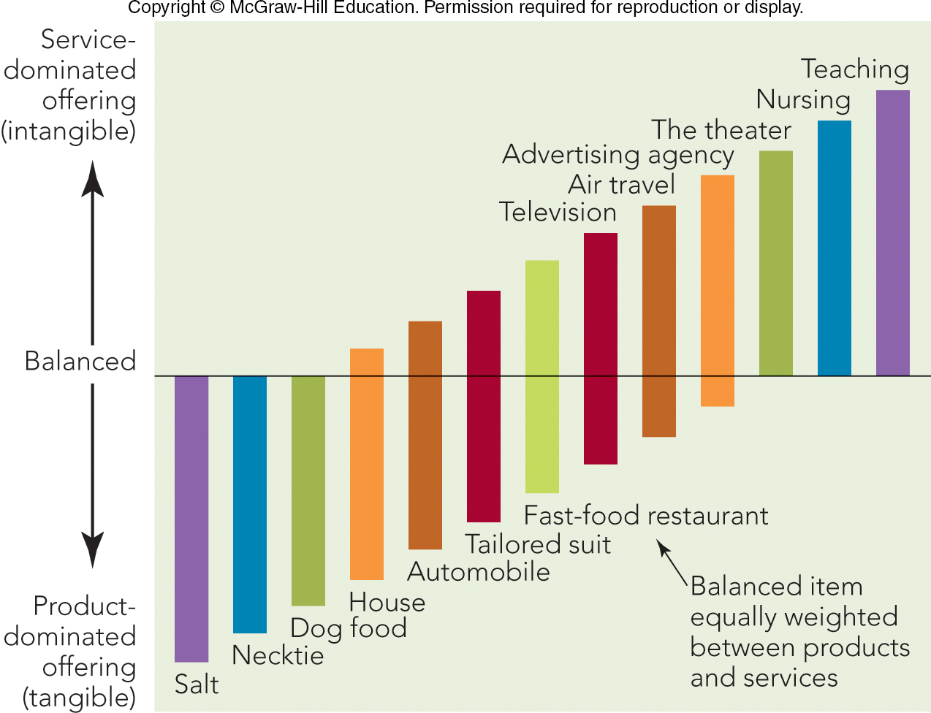
FIGURE 12-3 The service continuum shows how offerings can vary in their balance of products and services

